Slide 1

A Presentation to Quaker Africa Interest Group Meeting
1 March 2025

Slide 2
Introduction
  FWCC World Plenary Meeting (WPM) was held in South Africa,
  5 – 12 August 2024. Two outcome documents were developed:
  the tapestry and the Epistle.
  These have been shared with Friends worldwide and can be accessed on the website.
  The WO staff identified calls-to-action and translated them into a strategy document as highlighted in this presentation.
  This presentation is limited to the thematic areas under the role of the Justice and Peace Secretary.

Slide 3
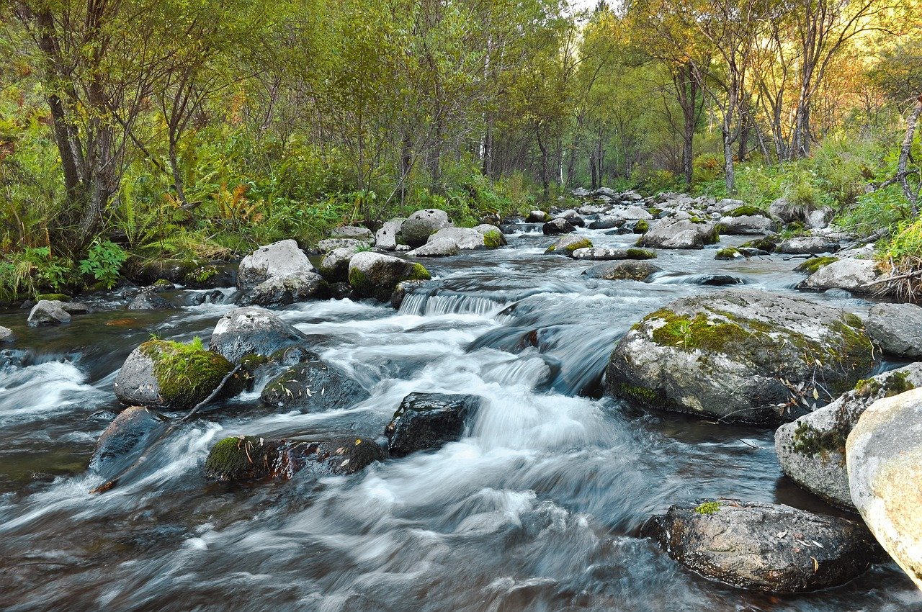
Dedication – inspiration from the tapestry
We dedicate ourselves to
  let the living waters flow through us – where we live, regionally and in a wider world fellowship
  building the ‘peace that passeth all understanding’, to the repair of the world, opening our lives to the Light to guide us in each small step’

Slide 4

Strategic Plan
Key steps
  Consideration by all four Sections
  Approval by the Central Executive Committee
  Presentation to the World Plenary Meeting
  Rooted in a faith-based theory of change, inspired by Matthew 13:1–23
  Final Document: Towards our future: Strategic Directions for FWCC (six priorities)
  The strategy sets aims, direction and key moments leading to 2027

Slide 5

Priorities
Six Priorities
  Action on the outcomes of the World Plenary Meeting
  Young Adult Friend Leadership and spiritual nurture
  Visibility of Quakers to the world
  Nurturing Quaker worship
  Addressing the digital divide
  Sharing resources – future arrangements for 4 Sections
  + 1 World Office

Slide 6
Solidarity with Suffering
Write to people suffering prison sentences, restricted movement/people on the move
Compassion for and in solidarity with the least means/suffering in society (asylum seekers, refugees, IDPs etc)
  Conscientious objectors (WRI)
  Quakers brought to FWCC attention by Yearly Meetings, facing prison or restricted movement due to any form of nonviolent work for peace or climate justice
  Working with partners for their release

Slide 7
Climate Justice
Proactively offer prayerful and financial solidarity with Friends and Friends supporting neighbours in the face of extreme weather events
A commitment to the Kabarak call in 2012
Acknowledge ecological destruction disproportionately driven by the rich, who must bear climate action
Prioritize climate and eco-justice and map actions for care for creation
  Coordination of Global Quaker Sustainability Network
  Strengthen Climate Emergency Fund

Slide 8
Historical and Continuing Injustice
Work with Sections to contact YMs to share Friends' concern for Historic and Continuing injustice
Make amends and to work for reparative and retrospective justice
Gather reports of any work towards addressing it at the 2027 online Plenary Meeting
Challenge false notions of white supremacy, to repudiate doctrines of discovery
Disrupt patterns of oppression and division, to acknowledge offences
Collaborate with or accompany programmes addressing similar concerns:
Dig deep into the pain and trauma of the world
  BYM Reparations Working Group
  Participatory Action Participation, Action, Research
  Reparatory and Retrospective Justice (PARR Group)
  Quaker Coalition for Uprooting Racism (QCUR) https://www.fgcquaker.org/
  Quaker Aboriginal Affairs Committee (CFSC)

Slide 9
Advocacy
Work with Quaker Agencies to challenge the corporations and governments which are failing to live up to their international climate and biodiversity commitments
Affirm QUNO
& Quaker agencies/ partners
Support and uphold Friends who take non-violent direct action
Advocate for assistance to developing countries that are particularly vulnerable to the adverse effects of climate change, in responding to loss and damage

Slide 10
Interfaith Collaboration
Write to churches and faith groups sharing our journey
Listen to that of God in others, and only then speak our truth with humility, in ways which others can hear
Explore collaborative ways to challenge false notions of white supremacy, to repudiate doctrines of discovery, and make amends in support of reparative and retrospective justice

Slide 11
Representation in QUNO / Quaker Agencies
Work with QUNC, QUNO and Nominations committees towards an increased representation of QUNC members from the Global South by 2027
Inequalities in international Quaker organizations (participation & representations) and delocalization
Encourage and where possible assist QUNO towards a target of an increased number of PAs and QUNO Summer School from the Global South
Explore opportunities for increased engagement with UN Bodies in the Global South, e.g. the UN Environment Programme in Nairobi

